Slide 1
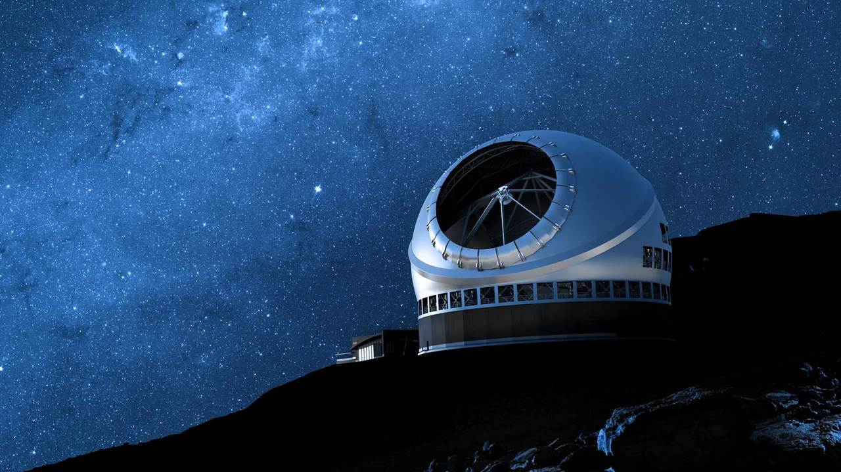
Vibration Measurement in Astronomical Observatories
Jonathan Zerez
Olin College of Engineering
Mentors:
Hugh Thompson, Lianqi Wang, Peter Byrnes
Organization:
Thirty Meter Telescope

Slide 2
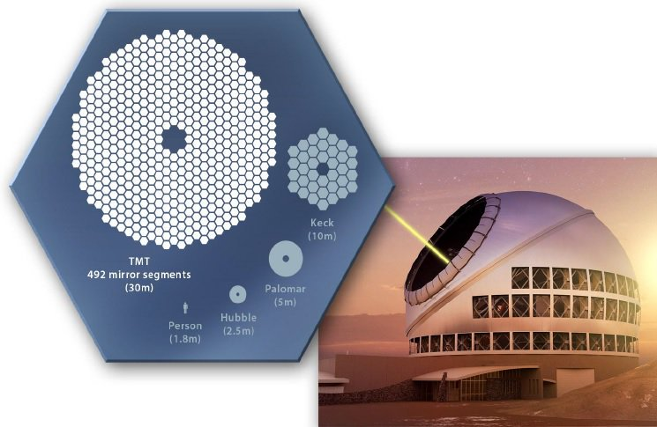
Extremely Large Telescopes
Basics of TMT:
TMT is massive
TMT’s Goal: Understand more about the universe
In order to achieve these goals:
Design parts that meet optical performance requirements
Notes:
30 meter diameter mirror, world’s current largest is 10 meters
Answer key questions about the structure and evolution of the universe
Explore the enigmatic processes, environments and bodies that encompass the universe.
Vibrations are the limiting factor of ground based telescopes. Trying to keep 70nm wavelength aberrations over a 30 meter area. 10^6.5

Slide 3
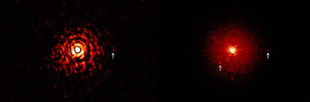
Vibrations are bad for Image Quality
Have many potential sources
Can’t always be eliminated
Point source without vibrations
Point source with vibrations
Notes:
Sources: Earthquakes, Wind, Elevation/Azimuth acutators, pumps, fans, cooling lines, bearings, etc
Vibration budget: systems engineering tool used to assign vibration requirements to components based on vibrational sensitiviy analysis. Lots of assumptions based on finite element modeling, needs validation with physical testing data. Garbage in, garbage out.

Slide 4
The Vibration Budget
FEA
Vibration Budget
Physical testing
& data acquisition
Analytical results
Assumptions
Validation
Define allowable levels of vibration
Finite Element Models used

Slide 5
FEMs need Validation
Transfer Functions
Vibrational Sources
Will current plans/components for the telescope meet requirements set out by the vibration budget?
Notes:
Vibration budget: systems engineering tool used to assign vibration requirements to components based on vibrational sensitiviy analysis. Lots of assumptions based on finite element modeling, needs validation with physical testing data. Garbage in, garbage out.

Slide 6
Project Overview
FEA
Vibration Budget
Physical testing
& data acquisition
Analytical results
Assumptions
Validation

Slide 7
Project Overview
FEA
Vibration Budget
Physical testing
& data acquisition
Analytical results
Assumptions
Validation

Slide 8



Data Acquisition Tools & Validation
MATLAB
-User Interface
-Data Processing
National Instruments
-Data Acquisition
ANSYS
-Simulation and modeling

Slide 9
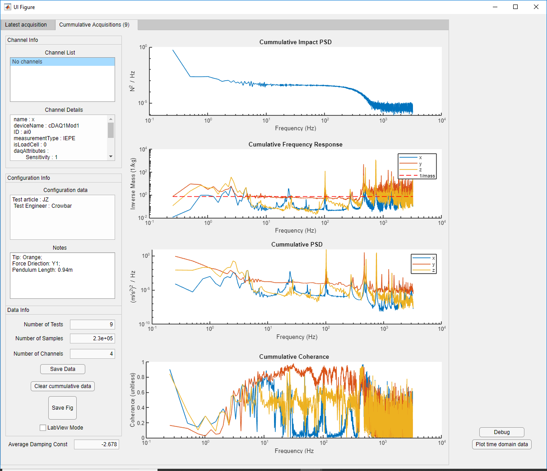
Specify collection settings
Impact Detection
Data processing, plotting, and averaging
Saving and loading data
Labview mode!

Slide 10

Testing Methodology
1
2
Impact Hammer (B&K 8207)
Accelerometer 1 (PCB Triaxial)
Article
Accelerometer 2 (PCB Triaxial)
Notes:
How was testing carried out?
-Used an instrumented impact hammer
-Used Accelerometer to read impulse response of the MSIT close to the impact location
-Used second accelerometer to read impulse response of MSIT far from impact locaiton and determine transfer function

Slide 11
Validating the tools
Ensure tools are processing data correctly on simple systems
Legitimize tool’s utility for more complex systems

Slide 12
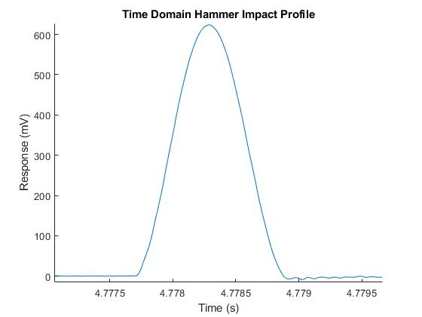
Impact Hammer
1
2
Notes:
Impact hammer used to carry out testing
-Puts an short impulse into the structure
-Covers wide range of frequencies
-Low signal to noise ratio, need to average multiple hits
-Notice timescale of time domain plot

Slide 13
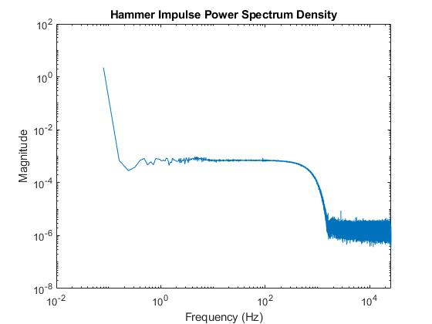
Impact Hammer
Even Frequency Distribution
Frequency Roll-off
1
2
Notes:
Impact hammer used to carry out testing
-Puts an short impulse into the structure
-Covers wide range of frequencies
-Low signal to noise ratio, need to average multiple hits
-Notice timescale of time domain plot

Slide 14
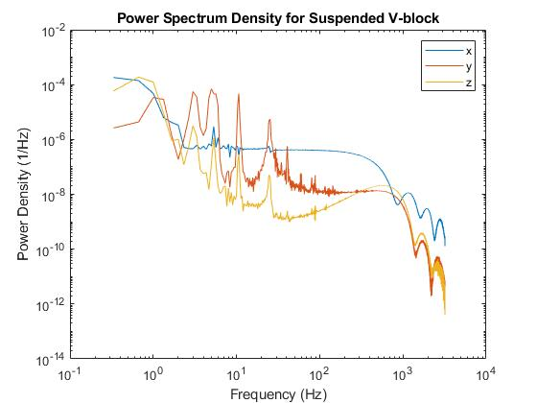
Accelerometer 1
Modes of pendulum cables
1
Rigid Body Frequencies
2
Notes:
Impact hammer used to carry out testing
-Puts an short impulse into the structure
-Covers wide range of frequencies
-Low signal to noise ratio, need to average multiple hits
-Notice timescale of time domain plot

Slide 15
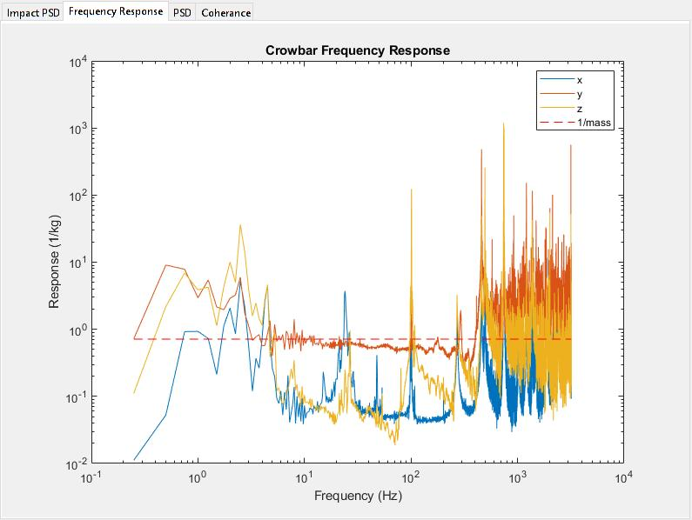
Article
1
Inverse Mass Line (known)
Inverse Mass Line (calculated)
2
Notes:
Impact hammer used to carry out testing
-Puts an short impulse into the structure
-Covers wide range of frequencies
-Low signal to noise ratio, need to average multiple hits
-Notice timescale of time domain plot

Slide 16
Additional Insights Generated from the Tool

Slide 17
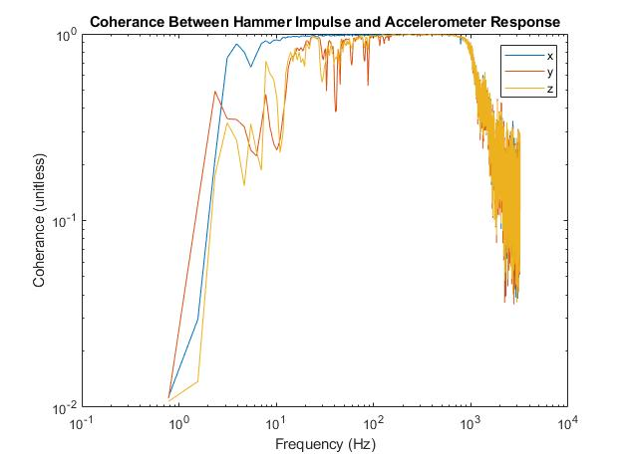
Accelerometer 1
1
Poor coherence at low and high frequencies
2
Notes:
Impact hammer used to carry out testing
-Puts an short impulse into the structure
-Covers wide range of frequencies
-Low signal to noise ratio, need to average multiple hits
-Notice timescale of time domain plot

Slide 18
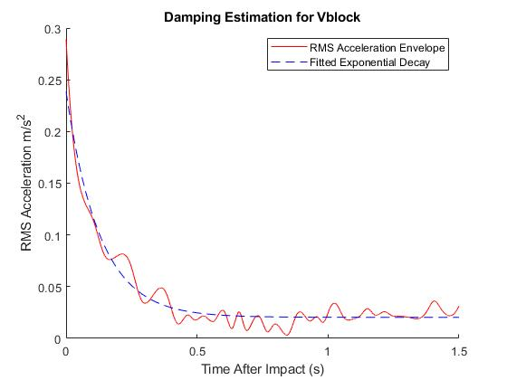
Article
1
2
Notes:
Impact hammer used to carry out testing
-Puts an short impulse into the structure
-Covers wide range of frequencies
-Low signal to noise ratio, need to average multiple hits
-Notice timescale of time domain plot

Slide 19
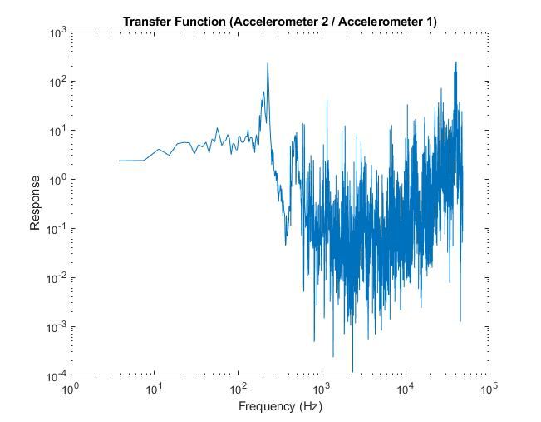
Accelerometer 2
1
Fundamental Frequency
Low Frequency Amplification
2
Notes:
Impact hammer used to carry out testing
-Puts an short impulse into the structure
-Covers wide range of frequencies
-Low signal to noise ratio, need to average multiple hits
-Notice timescale of time domain plot

Slide 20
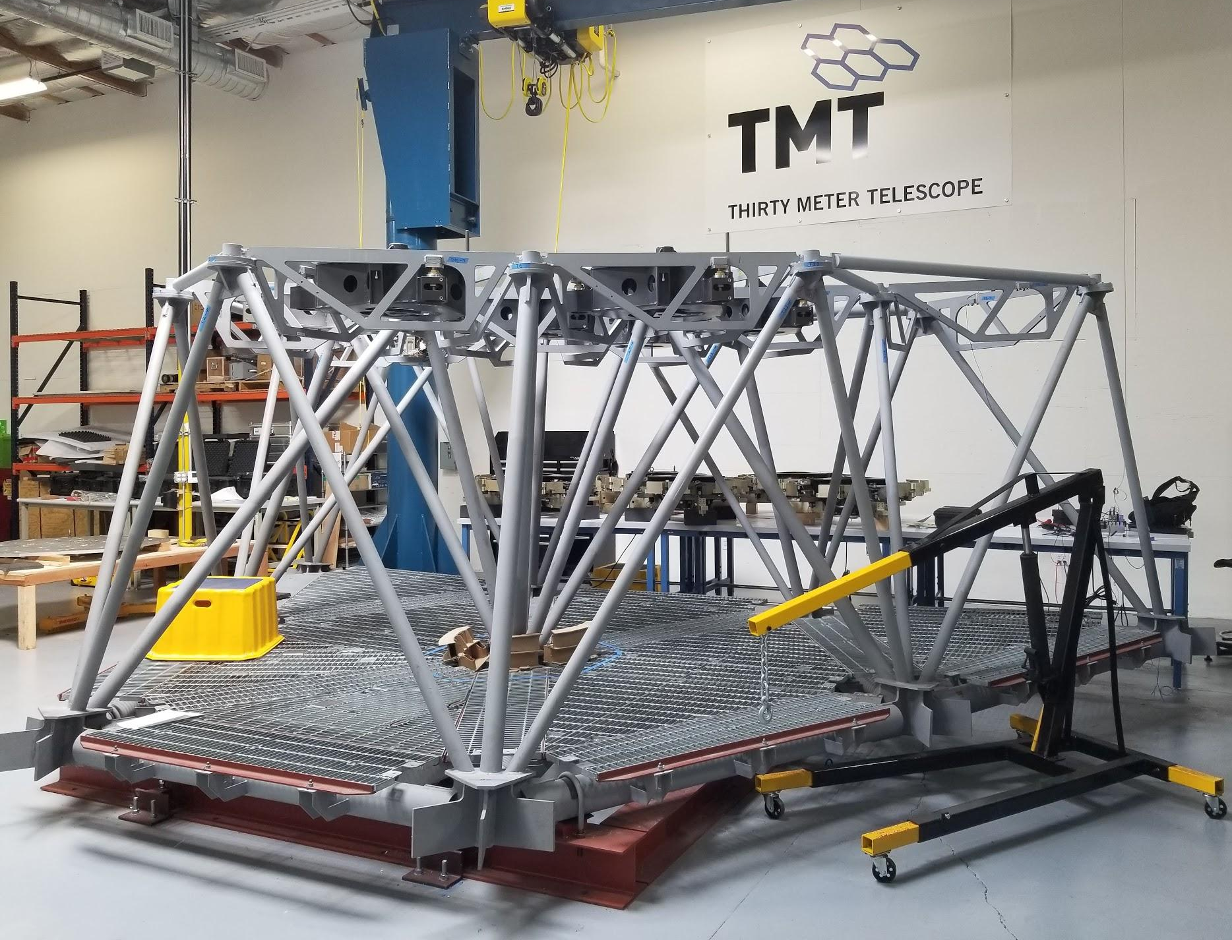
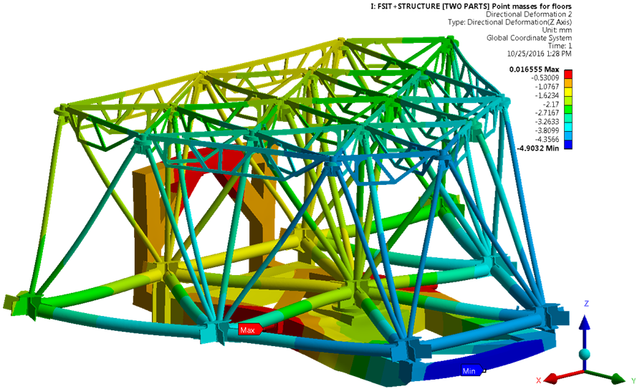
MSIT Background and Testing Rationale
The Multi-Segment Integration and Test (MSIT) structure
MSIT Ansys Finite Element Model (Static Structural)
Notes:
-This is the MSIT, it will be used to hold a series of 7 fixed frames and mirror segments for the purposes of testing and integration
-Lives in the monrovia lab
-Used in testing because:
-Has a corresponding CAD/FEM to extract analytical estimations to compare physical data
-Have easy access to physical structure
-Similar to the M1 support structure

Slide 21
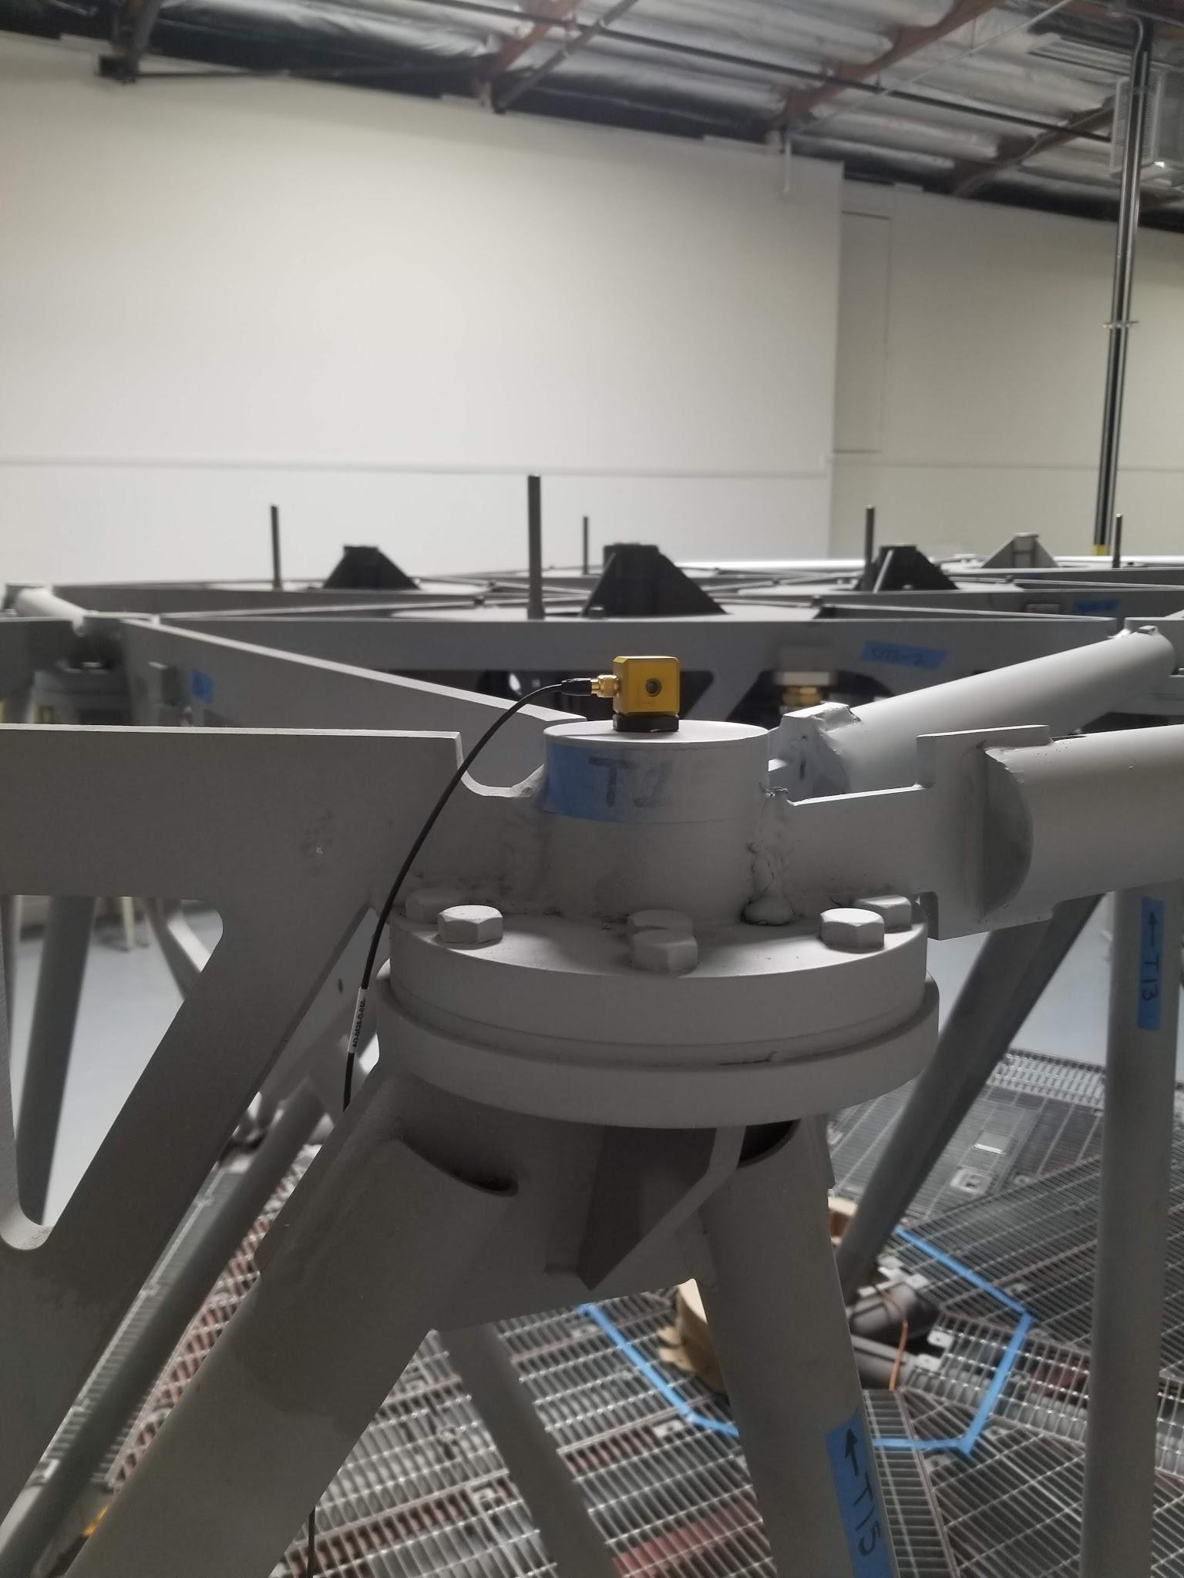
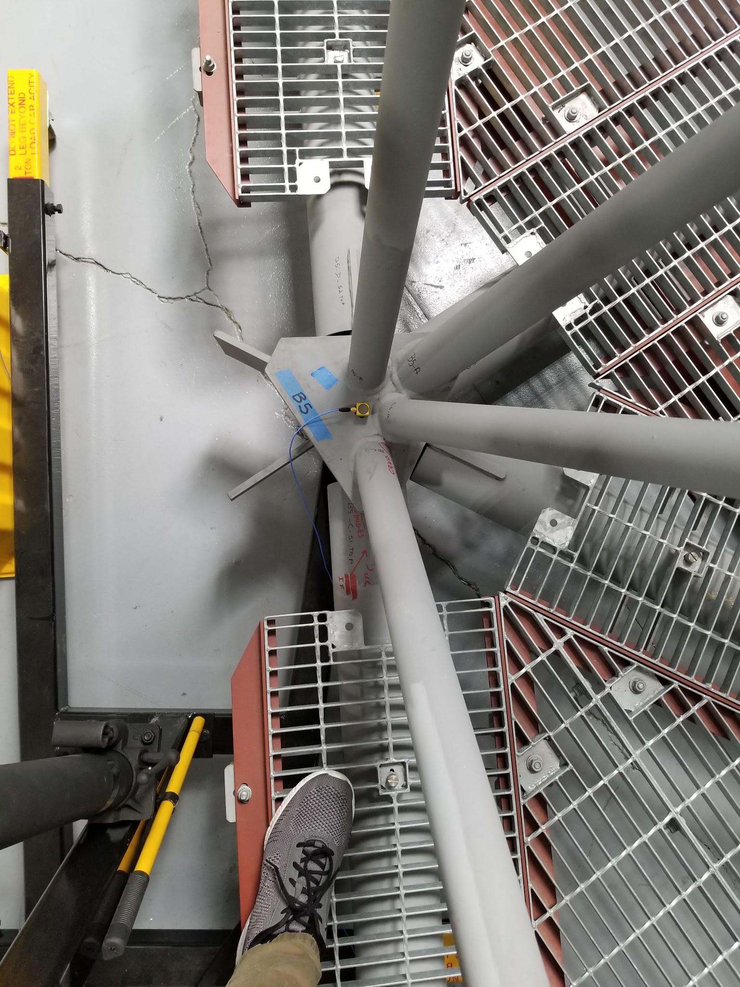
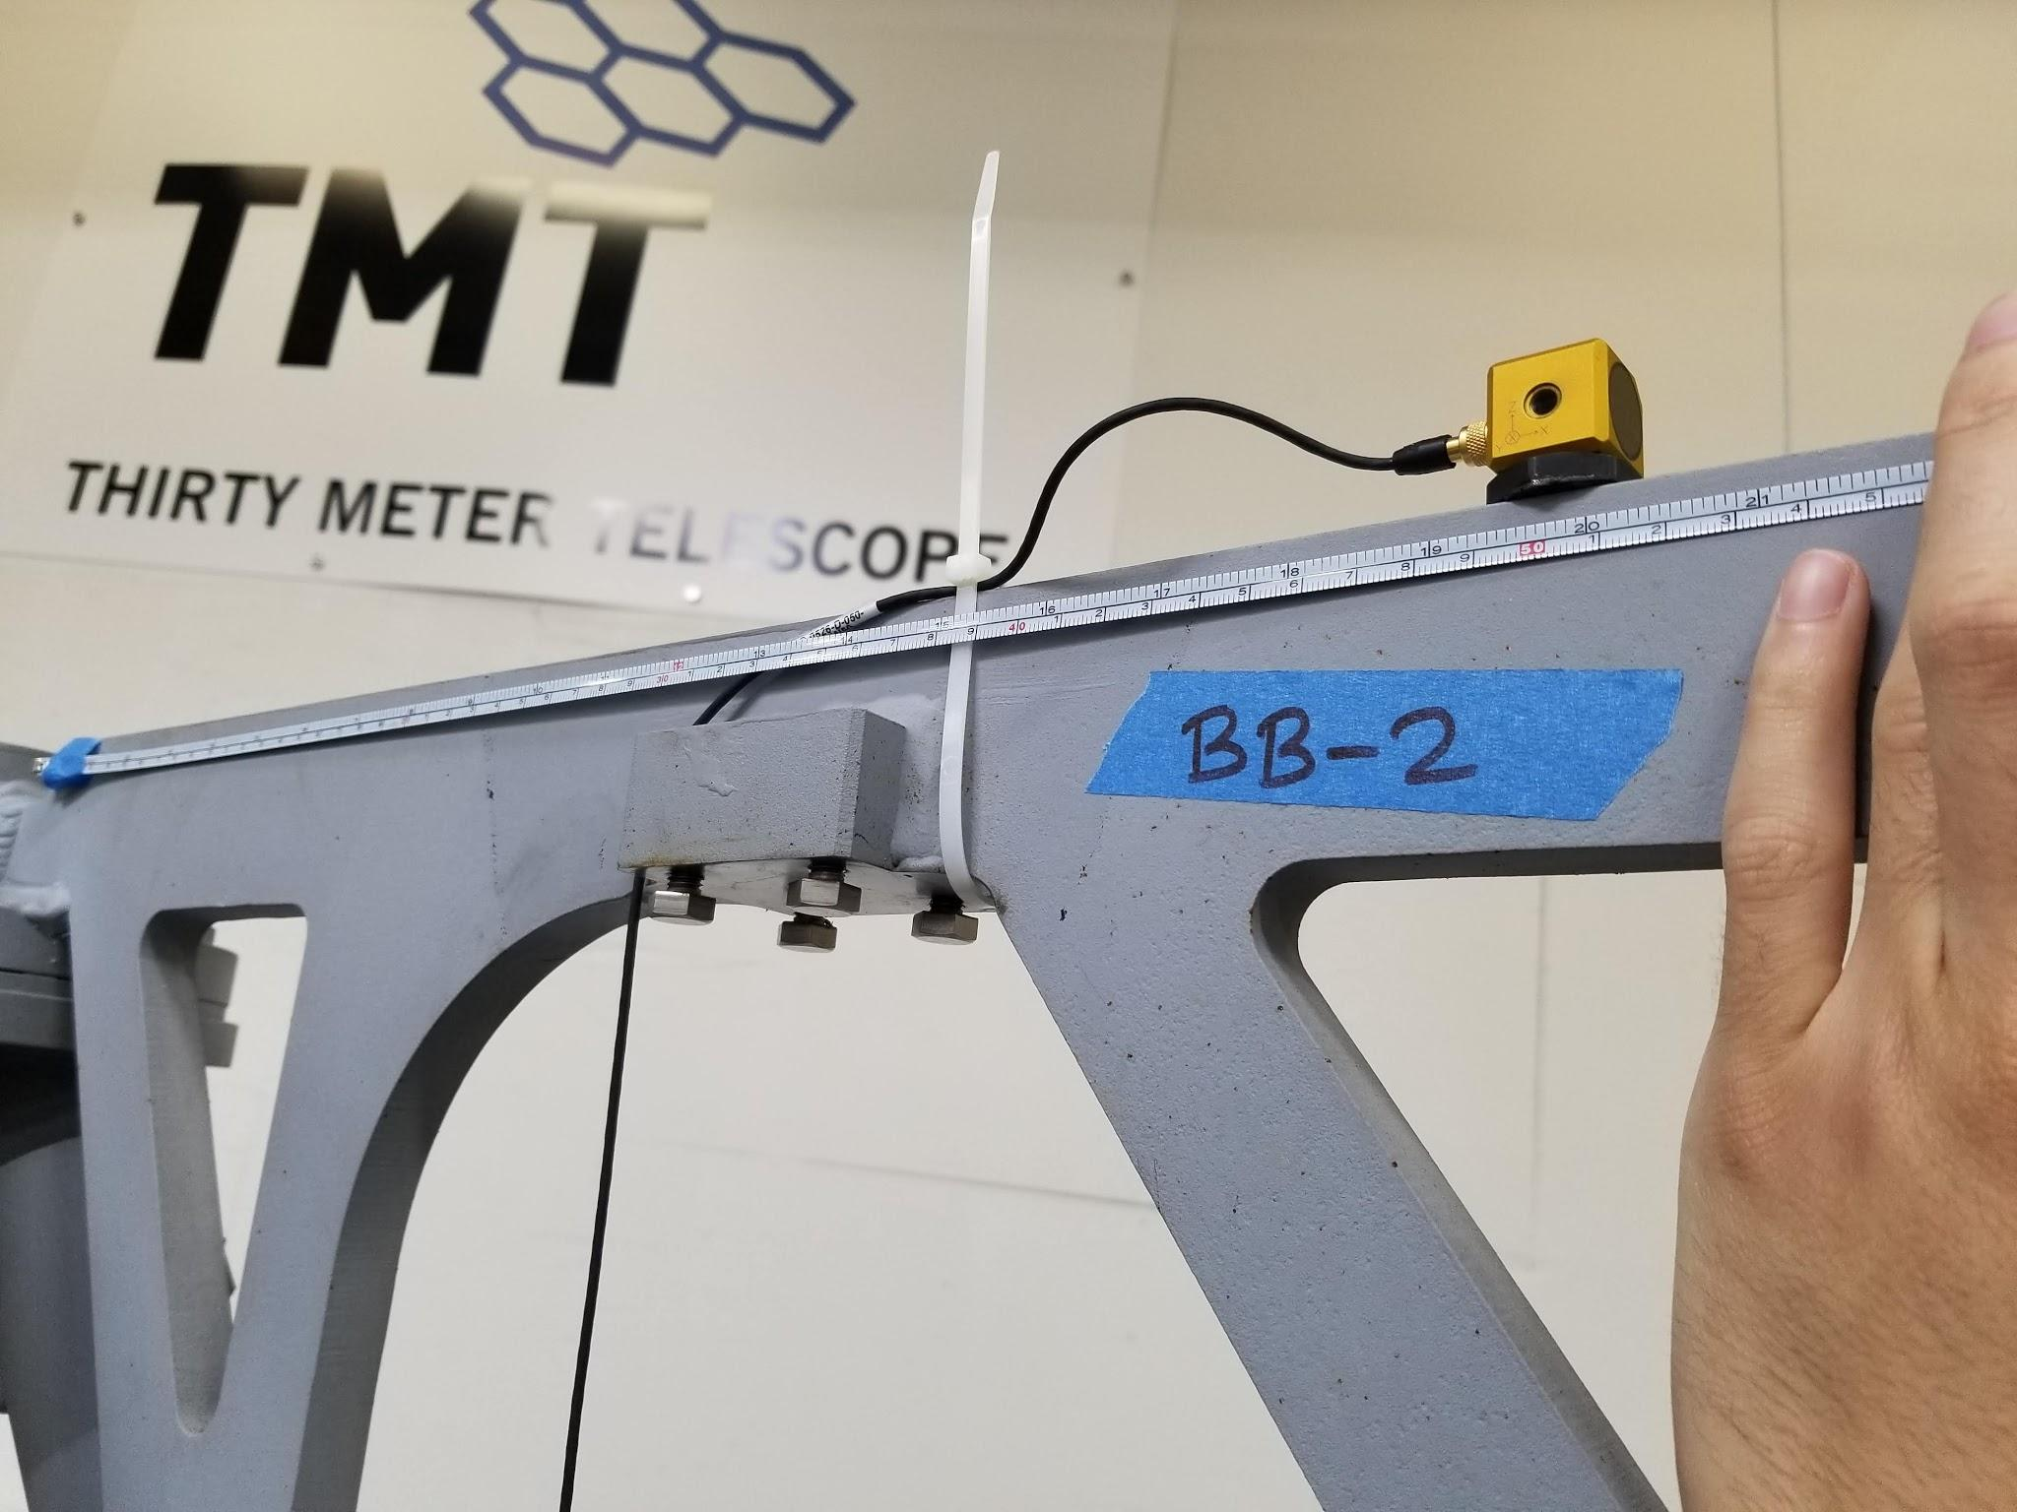

Slide 22
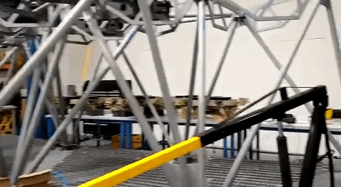

Slide 23
Summary
Developed and validated vibrational testing tool
Vibrational data acquired from the MSIT
Need to extract simulated characteristics of the MSIT to compare to real life data

Slide 24
Takeaways
Acquisition tools allow for efficient modal testing for engineers
Starting to close the loop of design

Slide 25


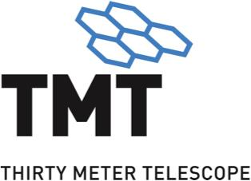






Acknowledgements
Hugh Thompson; TMT
Peter Byrnes; TMT
Lianqi Wang; TMT
Gelys Trancho; TMT
Jamie Nakatawase; TMT
Thirty Meter Telescope International Observatory
Akamai Internship Program
Institute for Scientist & Engineer Educators at UCSC
Funding
Thirty Meter Telescope International Observatory
Air Force Office of Scientific Research (FA9550-15-1-0427)
Hawaii Community Foundation Career Connected Learning Program
Daniel K. Inouye Solar Telescope
W. M. Keck Observatory (via NSF AST-1836016)
University of Hawaii at Hilo
Canada-France-Hawaii Telescope
Bryan Smith; TMT
Fred Kamphues; TMT
Chris Carter; TMT
Amir Sadjadpour; TMT
Doug MacMartin; Cornel

